Slide 1
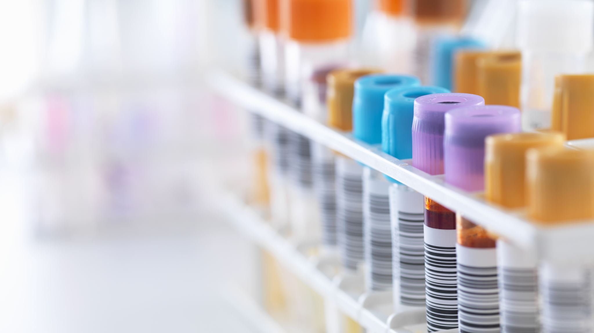
Supply Chain Analysis on Beauty Products
Team Members:
Yashu Bhati
Tanvi Vishnukumar Prajapati
Niraj Manjobhai Patel

Slide 2

Problem Statement
The business problem for the dataset is to optimize product recommendations to enhance customer personalization and increase sales.
To analyze the problem, the main factors which need to be analyzed are manufacturing costs, inspection results, and defect rates to evaluate and rank of brands & suppliers based on their performance and quality standards.
Analyze production volumes and costs to determine optimal production levels that maximize revenue while minimizing manufacturing costs.

Slide 3
Dataset Description
Dataset 1: https://data.world/usaid/supply-chain-shipment-pricing
Dataset 2: https://statso.io/supply-chain-analysis-case-study/
Merged Dataset:
The dataset was gathered from a startup in the fashion and beauty industries. Based on the supply chain, the dataset is about various product types like haircare, skincare & cosmetics.
The merged time-series dataset has 100 rows & 29 columns.
The dataset consists of information about sourcing, manufacturing, transportation, inventory management, sales and customer demographics, etc.

Slide 4
Manufacturing process of L'Oréal
Formula Ingredients Transportation
(480 min)
Formula Ingredients Extraction
(240 min)
Storage at Distribution Center
(600 min)
Packaging Materials extraction
(300 min)
Product Manufacturing
(260 min)
Packaging Production
(550 min)
Product Use
Storage At Retailer
(800 min)
Packaging Recycling
(2000 min)
Formula End Of Life
Packaging End Of Life

Slide 5
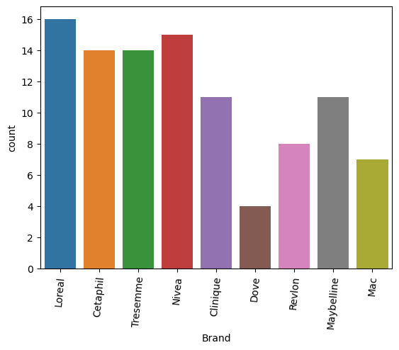
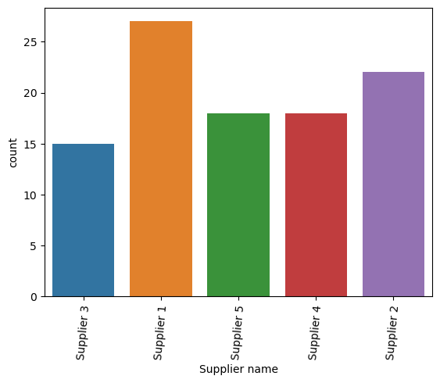
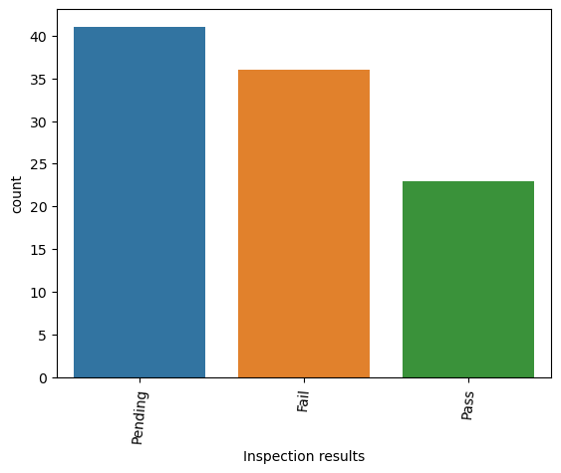
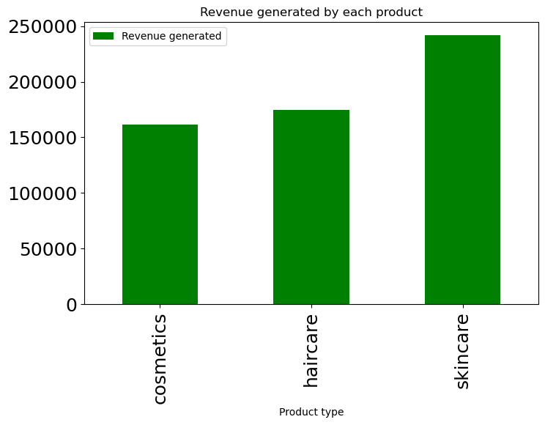
EDA

Slide 6
PESTLE analysis: L'Oréal Professional
Political
1) Not allowed to test its products on animals, as well as many Arab countries see the western products negatively.
2) This affected the company’s ambition to have presence in all the countries.
P
Economic
1) China & India, the fastest-growing economies offer expansion opportunities.
2) However, the global slowdown & trade war have caused reduced consumption, leading to low demand.
E
Social
1) The desire to showcase beauty and share it online has created opportunities for L'Oréal.
2) Today’s generation prefers home beauty products and environmental-friendly product.
S
Technological
1) L'Oréal embraces technology, invests in its R&D.
2) It also introduces new categories of products, engages with customers through social media, and offers innovative products.
T
Legal
1) L'Oréal faced legal battles against imitators, a lead contamination issue
2) It also false claimed about their product, resulting in legal actions.
L
Environmental
1) L'Oréal prioritizes sustainability by focusing on eco-friendly products, forest certification, greenhouse gas reduction.
2) It also participates in responsible sourcing.
E

Slide 7
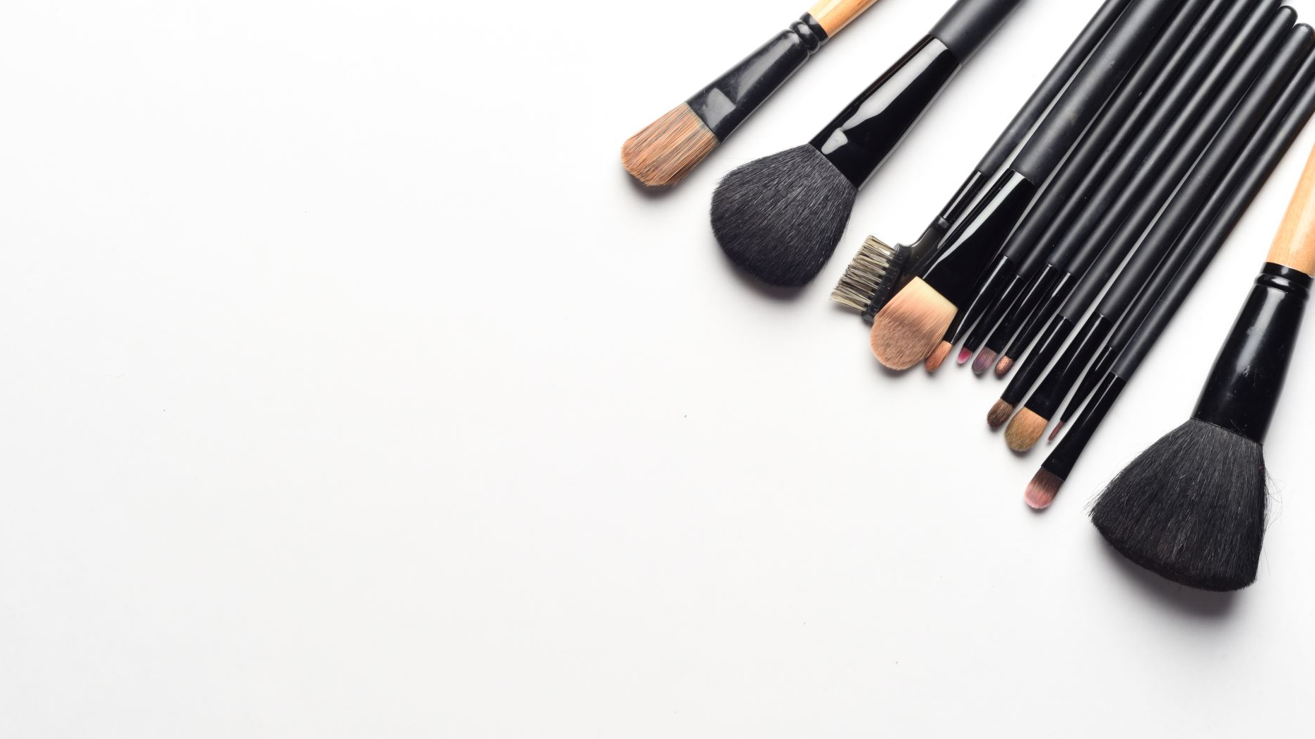
SWOT Analysis for L'Oréal
Strength
1) L'Oréal goes beyond affordable cosmetics, offer a range of brands worldwide and prioritize natural components.
2)Extensive R&D cater to functional and health beauty needs and has a global presence in over 150 countries.
Weakness
1) Complication arise in large-scale operation, including slow divisions and significant human capital expenses.
2) L'Oréal’s lower profit margins result from higher investments, yet R&D contributes to its industry-leading status.
Opportunities
1) Product line extension and introducing new items will drive overall expansion.
2) Growing demand for organic cosmetics aligns with L'Oréal's organic R&D focus.
3)Utilizing technology can enhance the brand image & improve personalized shopping experiences.
Threats
1) Intense competition exists in the cosmetics industry, coupled with economic downturns in various countries.
2) Despite L'Oréal's quality, some consumers may seek alternatives due to unmet demands.

Slide 8

DMAIC process of L'Oréal
Define Problem: The biggest challenge for L'Oréal is getting customers to come on board with sustainability with best quality of their product.
Measure: Monitoring raw materials and packaging quality is essential, including regular audits and laboratory tests for continuous improvement and strict control.
Analyse: Key priorities include reduction, tackling youth unemployment, advancing circular economy, monitoring climate change, promoting holistic thinking, ensuring social justice in climate transition, and business advocacy for policy change.
Improve: Public electric transport is increasingly accessible, lowering costs, benefiting the environment. Emerging energy storage and recycling technologies contribute to sustainability goals.
Control: Evaluate ingredient characteristics, usage patterns, and exposure levels to ensure consumer safety. International post-marketing surveillance ensures product safety worldwide.

Slide 9

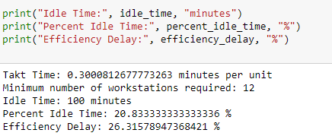
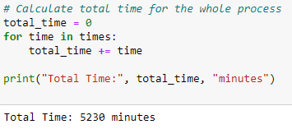
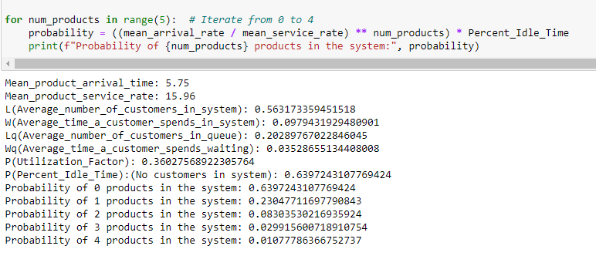
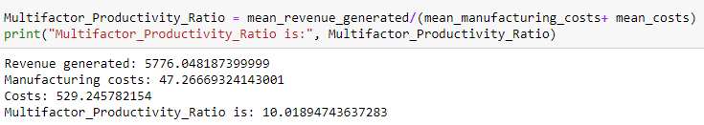
Calculations
1) Takt time
3) Loreal Map Process
The resulting line is not perfectly balanced. They will probably need to rotate employees across the workstations.
The total time taken for manufacturing process is 5230 minutes or 87.16 hours.
2) Queue Theory
4) Business Processes – Multifactor Productivity ratio
As the multifactor productivity ratio is 10.01%, therefore, a lower ratio suggests that there is potential for improvement in resource utilization and productivity.
The results shows that an average number of customers in the queue of 20.2 with an average wait time of 2.1 minutes and a 63% probability that an arriving customer will have to join a queue.
Note: Python Notebook for Calculation

Slide 10

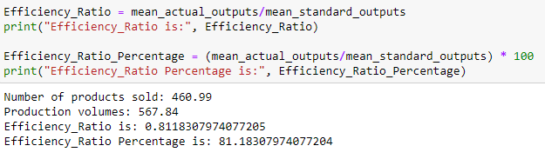
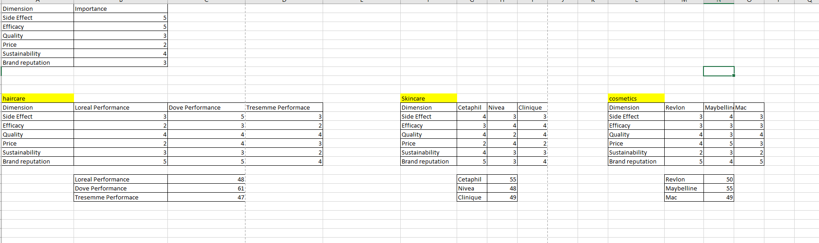
Calculations (Contd.)
5) Business Processes – Efficiency ratio
As the efficiency ratio is 0.81, therefore, a higher efficiency ratio indicates better utilization and productivity, implying that more output is being generated per unit of input.
6) Value Index
For haircare, Dove has a high value index out of other brands, which means that it is a better product and holds a greater value, which is 61.
For skincare, Cetaphil, has a high value index out of other brands, which means that it is a better product and holds a greater value among other skincare brands, which is 55.
Similarly, for cosmetics, Maybelline has a high value index out of other brands, which means that it is a better product and holds a greater value, which is Maybelline.

Slide 11
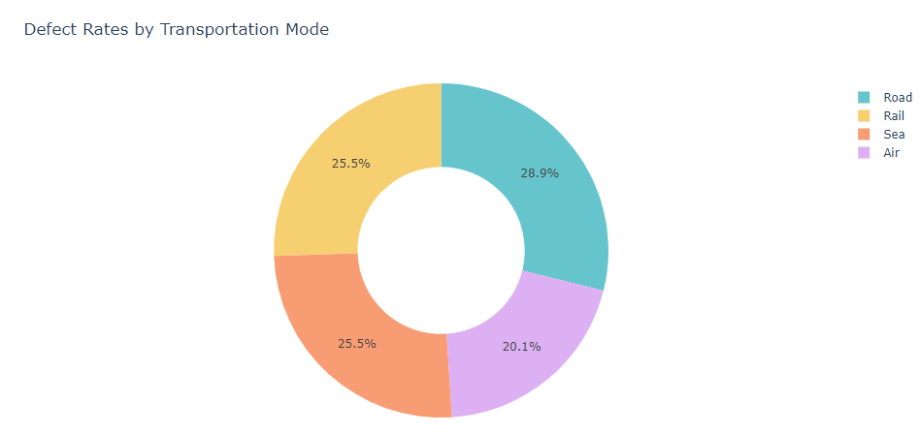
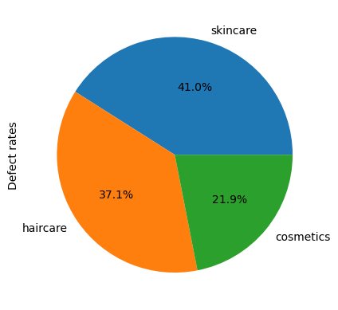
Results
Defect Rates by Product Type
Air transport has the lowest defect rate of 20.1%, whereas road transport has a higher defect rate of 28.9%.
Cosmetics has the lowest defect rate of 21.9%, whereas Skincare has a higher defect rate of 41%.

Slide 12

References
https://www.loreal.com/en/articles/commitments/our-methodology/
https://www.edie.net/loreals-biggest-challenge-is-making-sustainability-desirable/#:~:text=L'Or%C3%A9al's%20biggest%20challenge%20is%20getting%20consumers%20to%20come%20on,responsibility%20and%20sustainability%20Alexandra%20Palt.
https://mitefcee.org/sustainability-challenges/

Slide 13
Thank You

